Slide 1
The Rationale for Literature

Slide 2
The Why of Literature
The What of Literature

Slide 3
The ‘What’ before the ‘Why’

Slide 4

What does literature do?
Presents human experience

Slide 5

Not just records,
it interprets life

Slide 6

Tries to make sense of life,
reflects on the meaning of life

Slide 7

Asks and answers big questions of life

Slide 8

Interferes

Slide 9

Involves

Slide 10

Empathizes

Slide 11


Empowers

Slide 12
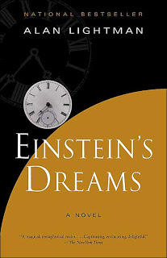
Thinks different

Slide 13


Envisions

Slide 14

In short…. makes you human

