Slide 1
Career Functions of English
Dept of English
Christ College
Irinjalakuda

Slide 2
Functional English
Career Implications

Slide 3
Functions of English
------------------------------
-------------------------------
--------------------------------
---------------------------------

Slide 4
Functions of Language
Communication
Image Building
Career Building

Slide 5
Functions of English
Communication
Image Building
Career Building

Slide 6
Career Building & Language
Career skills
Role of language in career skills

Slide 7
Vision for 21st Century Learning-Learning and Thinking Skills
  Critical-thinking and problem-solving skills
  Communication skills
  Creativity and innovation skills
  Collaboration skills
  Contextual learning skills
  Information and media literacy skills

Slide 8

Vision for 21st Century Learning -Life Skills
  Leadership
  Ethics
  Accountability
  Adaptability
  Personal productivity
  Personal responsibility
  People skills
  Self-direction
  Social responsibility

Slide 9
Skills from a Language Degree
Communication (written + verbal)
Intercultural perspective / global view
Analysis and Research
Flexibility
Creativity
Self Reliance, Initiative and Confidence

Slide 10
Top Skills Employers Seek in Candidates
Analytical Skills
Communication Skills - verbal and written
Computer Skills
Creativity
Detail-Oriented
Entrepreneurial Skills/Risk-Taker
Flexibility/Adaptability
Motivation/initiative
Honesty/Integrity
Interpersonal Skills
Leadership/Management Skills
Organizational and Time Management Skills
Real Life Experiences
Self-Confidence
Strong Work Ethic
Tactfulness
Teamwork Skills
Technical Skills
Well-mannered/Polite

Slide 11
Language functions for Teamwork
What kinds of language functions are important for team building ?
Listening
Agreeing to disagree
Polite Suggestions etc .

Slide 12
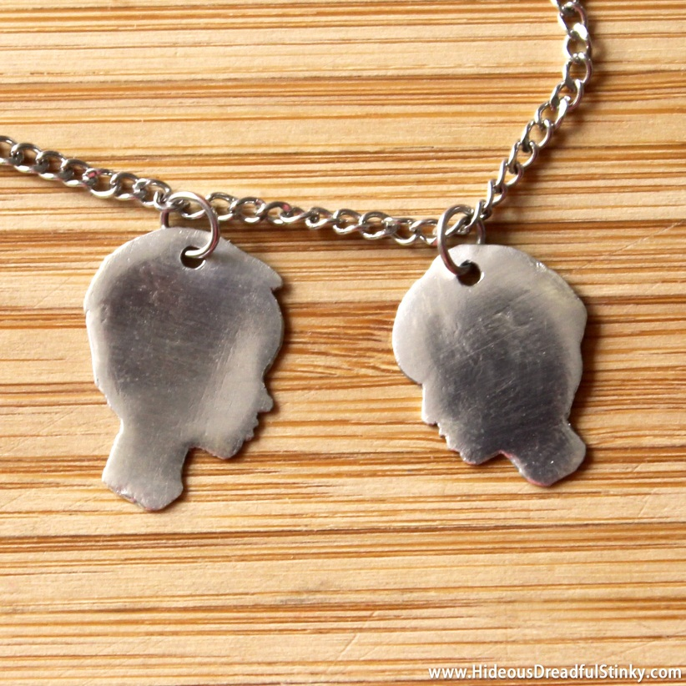
General qualities of effective communication
Clarity
Simplicity
Brevity
Slowness

Slide 13
General Qualities of Impressive Communication
Phrasal Verbs
Idioms
Pronunciation
Accent
Modulation
Expression of emotions

Slide 14
Phrasal verbs
Ask around
Drop back
Hang in
Put up with
Stay up

Slide 15
Phrasal verbs
Ask around - ask many people the same question
Drop back - move back in a position/group
Hang in - stay positive
Put up with - tolerate
Stay up – stay awake, waiting …

Slide 16
Idioms
Jaw drops
jog someone's memory
jump the lights
backhanded compliment
whole new ball game

Slide 17
Thank you for your time
P. K. Babu., Ph. D.
+91 9656 000 305
babu.peekay@gmail.com

